Slide 1
Computer Modelling and Simulation
Lecture 3

Slide 2
Agent-Based Modeling
Is an approach to modeling systems based on autonomous and interacting agents
Agent-Based Modeling (ABM) is the idea that the world can be modeled using agents, an environment, and a description of agent-agent and agent environment interactions
Is a bottom-up process
Defines emergent phenomena from micro-behaviors

Slide 3
Agent-Based Modeling
An agent is a persistent thing which has some state and which interacts with other agents, mutually modifying each other’s states
The components of an agent-based model are:
A collection of agents and their states
Rules governing the interactions of the agents
Environment within which they live
Interaction among agents is the central point of the simulation
Agent-based modeling is used to model complex systems

Slide 4
Complex Systems
A system composed of many interacting parts in which the emergent outcome of the system is a product of the interactions between the parts and the feedbacks between that emergent outcome and individual decisions
Emergence = ‘the action of the whole is more than the sum of the parts’ (Holland, 2014)
Feedbacks = The effect of the emergent result on the decisions of the individuals

Slide 5
Complex Systems Characteristics: Leverage Points
Leverage points are places where the complex system can potentially be shifted from one regime to another with the least effort (Bankes, 1993)
Tipping Points: places where a small change in an input can
dramatically affect the outcome (Scheffer, 2010)
Complex Systems analysis often gives you the most when it tells you the least

Slide 6
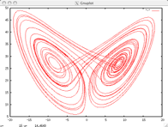
Complex Systems Characteristics: Sensitivity to Initial Conditions
Sensitivity to Initial Conditions (The Butterfly Effect):
in its strong form a condition of chaos which says that every starting point is arbitrarily close to another starting point with a significantly different future (Lorenz, 1972)
Chaos: when the present determines the future, but the approximate present does not approximately determine the future. — Lorenz
Weak Version - Where you start matters significantly

Slide 7
Complex Systems: Non-Linearity and Dynamics
Inputs do not necessarily affect outputs in a linear manner
Interactions between various inputs mean that you can not just solve problems by breaking them down one-by-one

Slide 8
Complex Systems: Heterogeneity and Inter-connectedness
Individuals in Complex Systems are often significantly diverse and heterogeneous (Page, 2010)
Most traditional modeling approaches fail to accurately capture the heterogeneity of individuals
Interconnectedness and Interactions
Individuals are connected and affect each other’s decision

Slide 9
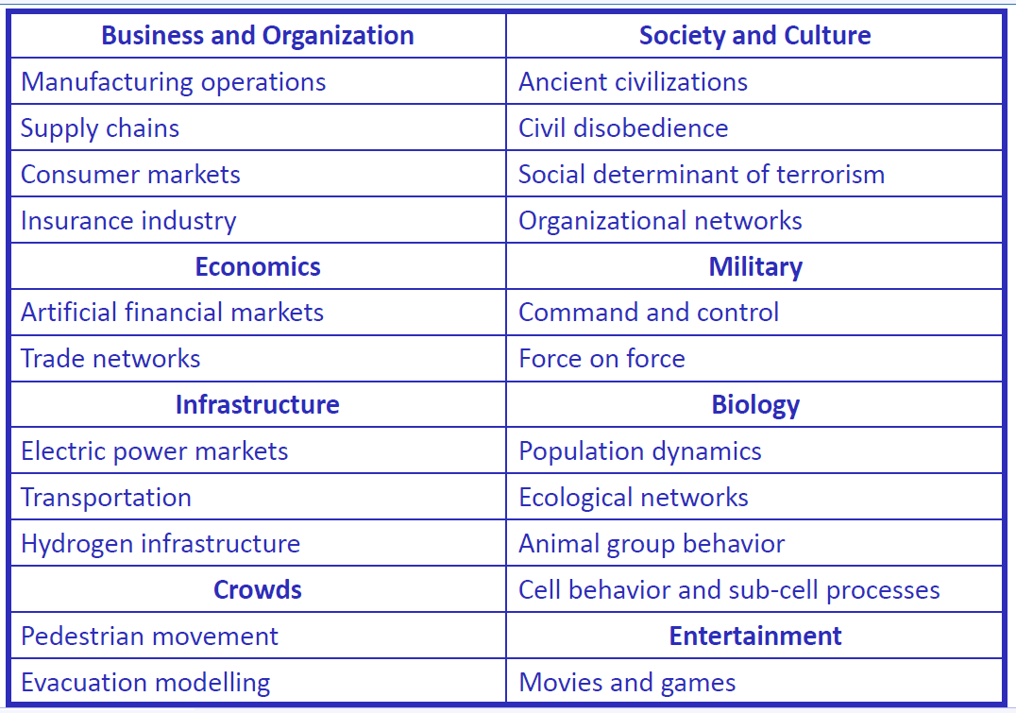
Applications of Agent-based Modeling

Slide 10
Example models reviewed in class
Segregation model
Sugarscape 1
Sugarscape 2
Sugarscape 3

